Slide 1
Smart Products. IoT. M2M. Do I Care?
Clemens Vasters, @clemensv Principal Architect, Technical Strategy Windows Azure Mobile, Microsoft Corporation

Slide 2


The “Internet Of Things” …

Slide 3
… is neither really about “Things” …

Slide 4
… nor really about “The Internet”, …

Slide 5
… it’s about creating systems …

Slide 6
… that make the tools of our daily lives better, …

Slide 7
… safer, more reliable, more efficient, …

Slide 8

… and more fun.

Slide 9
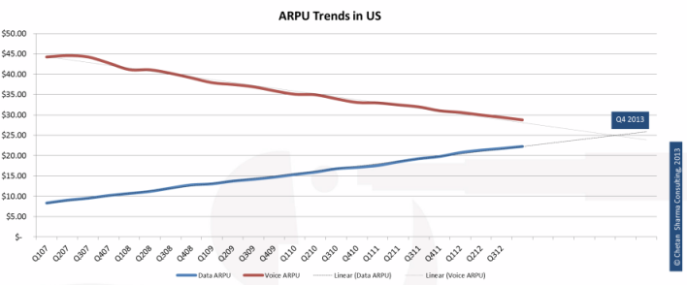
IoT is Hot. Here’s One Reason.
http://gigaom.com/2013/03/13/2013-the-year-mobile-data-revenue-will-eclipse-voice-in-the-us/screen-shot-2013-03-13-at-12-10-41-pm/

Slide 10
Smart Products
Patients
Smart Health-care
Manufacturing Integration and Automation
Clinics
Smart Pro Services
Remote Servicing
Mobile Care
Hospitals
Cars
Aircraft
Smart Factory
Fire
Nursing Homes
Smart Mobility
Pollution Control
Traffic
Buses
Emergency
Smart Cities
Renewables
Trains
Bikes
Predictive and Reactive Maintenance
Water
Smart Energy
Public
Safety
Oil/Gas/Coal Recovery and Distribution
Vessels
Trucks
Waste
Law Enforcement
Grid
Letters
Games
Hotels
Automation
Packages
Smart Logistics
Events
Smart Entertain-ment
Smart Building Home
Fuel Stations
Smart Retail
Lighting
Containers
Sports
Comfort
Points of Sale
Tanks
Bulkware
Streaming
Security
Safety
Television
Restaurants

Slide 11


Minimal Wait
3
1
1
1
3
3
2
1
3
2
2
4
1
👫
2
1
1
3

Slide 12

Ad-Hoc Stop

Slide 13








Traffic Alert!
3
1
1
3
3
2
1
3
2
4 (+2)
4
6 (+5)
2
🔔 14:30 🚌 14:41
3

Slide 14



E-Charging Preventive Repairs
7km
45km

Slide 15
Smart Mobility
Automated Emergency Call Systems
Predictive Maintenance
Entertainment Services
Fleet Management
Car Sharing
Traffic Management
Floating Car Data, Route Optimization, Cruise Control Optimization

Slide 16
Smart Grid
Manage Capacity
Wind and Solar Energy
Consumers becoming energy producers
Electric vehicles
Optimize equipment reliability
Optimize billing and pricing models
Enable smarter energy management at home

Slide 17
“Internet of Things”
Mobility
Logistics
Smart Products
Telemetry-Driven Data-In-Motion and Data-At-Rest Analysis
Dynamic Optimization of Operational Parameters
Remote Command, Control, and Servicing
Scalable Machine-To-Machine Communication
Industrial Products Scale (10+ Thousands)
Consumer Products Scale (10+ Millions)
Standard Protocols (Links, Transport, Application)
End-To-End Secure Communication
→ Business Process Integration and Enablement
Factory
Cities
Entertainment
Energy
Healthcare
Buildings
Retail

Slide 18

Enabling Smarter Products: M2M
Peer-to-Peer
Device-to-Service
Service-to-Device
Machine-to-Machine communication is non-interactive, automated, and bi-directional information exchange in operational systems, performed between peers or between satellite systems and their supporting backend services.

Slide 19

M2M Information Exchange Patterns
Telemetry
Information flowing from a device to other systems for conveying status of device and environment
Inquiries
Requests from devices looking to gather required information or asking to initiate activities
Commands
Commands from other systems to a device or a group of devices to perform specific activities
Notifications
Information flowing from other systems to a device (-group) for conveying status changes in the rest of the world

Slide 20
Real-time Analysis
Observe Telemetry “as it happens”
React to state changes or trends
React to aggregate observations
Examples
“device input voltage drops below 11V for more than 3 minutes”
“temperature readings from sensors on this floor average above 23°C for last 10 minutes”
“sensor failed reporting data for 5 minutes”
Very short reaction time required
fn

Slide 21
Data-At-Rest Analysis
Mine Telemetry through DB Queries
Find and track trends or maxima
Analyze expected vs. actual behaviors
React to longer term observations
Hoard for future use
Variety of Data Store Options
SQL/OLAP
Cassandra, Riak
Hadoop/HDInsight
Store choice depends on what questions you’d like to ask
flt

Slide 22
Command/Control
Tell a device, remotely, to execute a logical or physical activity
“Give me the status of X”
“Roll 2 feet forward”
“Track this object with the camera”
“Fetch firmware update”
Remote: Control service, handheld device, etc.
Latency requirements vary, but often “perceptibly imminent”

Slide 23

Communication
HTTP/S
AMQP/S
MQTT
Custom Protocols
CoAP
TCP
UDP
ICMP etc.
IP
GSM/GPRS/HSPA/LTE
Weightless
White WiFi 802.11af
Zigbee IEEE 802.15.4
Bluetooth IEEE 802.15.1
WiFi IEEE 802.11x
ATM
Ethernet IEEE 802.3
PowerLAN/Homeplug

Slide 24
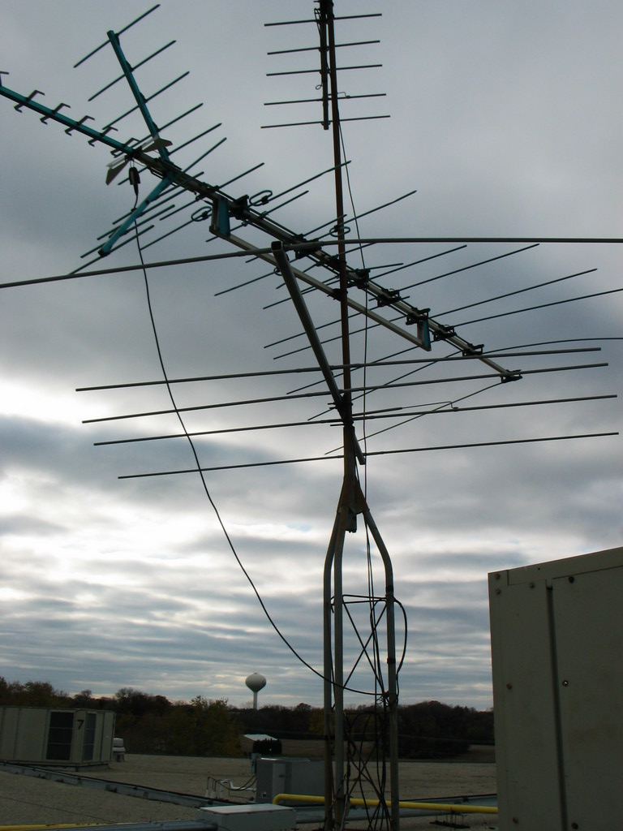
Connectivity
M2M’s Key Battleground
Mobile Operators
Public APNs via Internet
Private APNs to private networks
(Analog TV) white-space radio
Other short-/mid-range radio
Power-line Networks
Two fundamental models
Datagram Messaging
Stream exchange
Gateway/Bridge devices common

Slide 25
IPv6
6
IPv6 is generally, in the M2M community, seen as the solution for the “billion devices” problem
No address space constraints for the foreseeable future
Eliminates the need for NAT
Can route traffic directly to the device
Big caveats
Deployment is still slow, not pervasively supported
Not a sufficient addressing solution for roaming devices at significant scale
Actively listening network devices must be able to defend themselves

Slide 26
VPN
VPN
VPN is, in absence of IPv6, commonly seen as the solution for establishing device addressability
Perceived as establishing a secure connectivity realm
Reversal of traffic (inbound traffic carried via outbound connections)
Addressability on subnet with DHCP/DNS
Big pitfalls
VPN is Ethernet w/ eavesdropping-proof cables. Not a security solution.
Very expensive to scale, expensive handshake, significant overhead
Putting untrusted devices into a shared VPN space is security madness
Actively listening network devices must be able to defend themselves

Slide 27
Actively listening network devices must be able to defend themselves
Triage Legitimate and Illegitimate Connections/Traffic
Capture and Share Security-Related Incidents
Retain Operational Health During Incidents

Slide 28
Service Assisted Connectivity
DNS +
Device Mapped via Mplx Protocol or Port
Connections are device-initiated and outbound (like VPN)
NAT/FW Device (Router)
Service Gateway
Client
Device does not actively listen for unsolicited traffic (unlike VPN)
Port Mapping is automatic, outbound (like VPN)
Public address, full and well defendable server platform
No inbound ports open, attack surface is minimized
IPv4 NAT

Slide 29
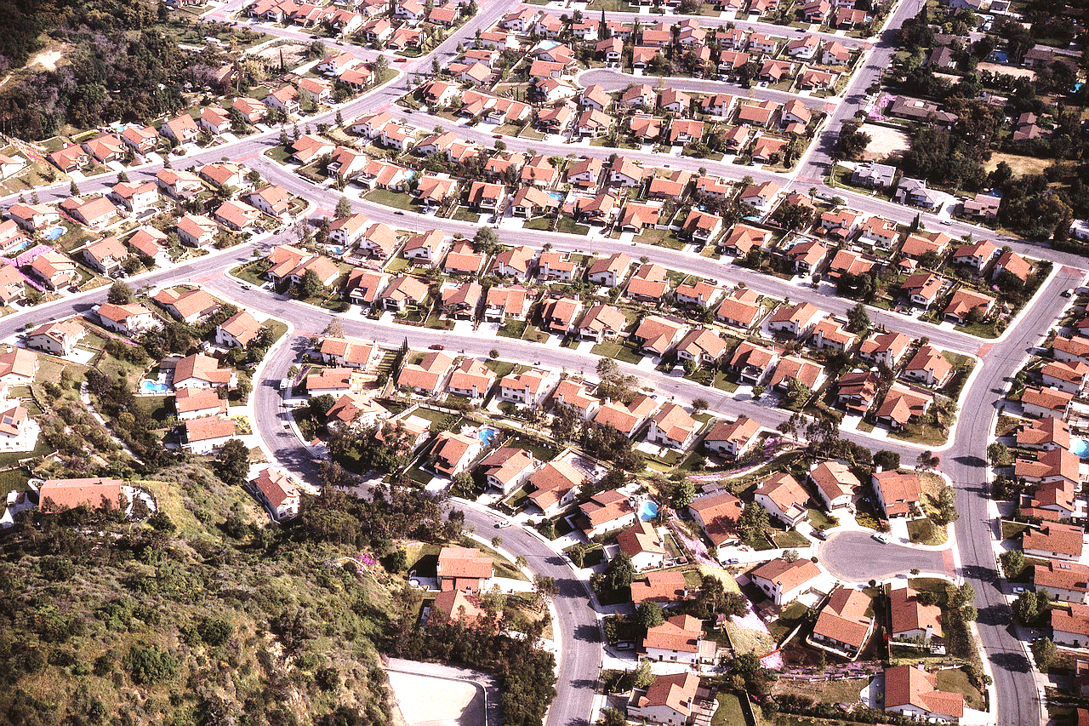



The Scalability Challenge
Smart Mobility
Smart Grids
Smart Homes
Smart Buildings
Smart Factory
Smart Logistics

Slide 30

Web Scale – Millions of Users!
But obviously not concurrent:
Frequency of Visits?
Time on Site? Time On Page?
Batch of HTTP requests per page with supplemental AJAX requests
2-10 concurrent keep-alive connections (max idle 1-2 minutes)
Wide variety
Facebook vs. Fashion-Store

Slide 31

App Scale – Millions of Users!
But obviously also not concurrent
App launches per day? (~7-8 overall per user and device)
Local interactions vs. cloud requests?
Frequency of cloud requests?
Alerting via platform infrastructure
Wide variety
Most time spent is on Games, Social, Entertainment apps (>64%), Browser %20.
*Data from Flurry.com

Slide 32
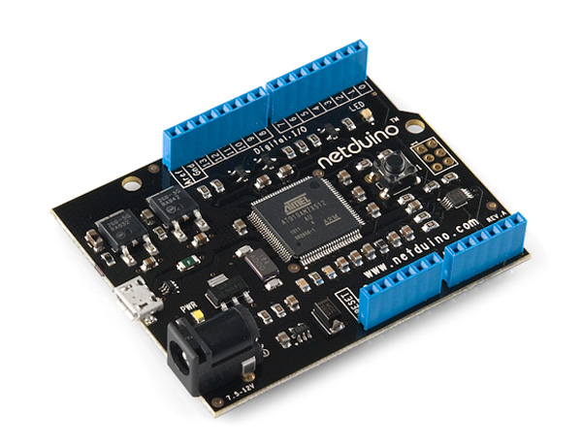
M2M/IoT – Millions of Devices
Concurrent!
Telemetry
Telemetry records per day, hour, minute, seconds?
Frequency determines concurrency
Lossy vs. reliable?
HTTP vs. AMQP vs. MQTT vs. Custom
Command and Control
Acceptable command latency?
Latency drives connectivity requirements

Slide 33
Device Capabilities
Volume products mean miniscule price differences having huge impact
Broad array of very special microcontrollers and communication circuits
Microcontrollers ~$1+, Ethernet + TCP/IP ~$3+, GSM/GPRS ~$15, RF ~$3
Physical constraints matter
Small size footprint, minimal energy consumption
Few KBytes of RAM and program storage are fairly common

Slide 34
Scenario Architecture – Connected Car
100,000s of Drivers
100,000s of Vehicles
100,000s of Drivers
3G
Mobile Platform Push Messaging
Mobile Solution Backend
Telematics Gateway
Web Portal
Windows Push Messaging
Notification Fan-Out
Web PaaS/BaaS
Messaging
Web PaaS
Messaging
Notification Fan-Out
+ Find My Car
+ Geo Fencing
+ Remote Diagnostics
+ Driving Behavior
+ Predictive Maintenance
+ User Targeting Data
+ Points Of Interest
+ Traffic & Parking
+ Seamless Navigation
Mobile Experience
Portal Experience
Vehicle Information Systems
Fleet Information Systems
Driver Assistance Systems
3rd Party Content Points of Interest, Coupons, Easy Parking
ERP
Roadside Assistance
Customer Relationship Management
Maintenance and Dealers
User Profiles Preferences, Entertainment Navigation Destinations, Presence

Slide 35
Seamless Navigation
100,000s of Drivers
100,000s of Vehicles
100,000s of Drivers
3G
Mobile Platform Push Messaging
Mobile Solution Backend
Telematics Gateway
Web Portal
Windows Push Messaging
Notification Hubs
Web Sites
Service Bus / Device Hub
Web Sites
SignalR + Service Bus
Notification Hubs
+ Find My Car
+ Geo Fencing
+ Remote Diagnostics
+ Driving Behavior
+ Predictive Maintenance
+ User Targeting Data
+ Points Of Interest
+ Traffic & Parking
+ Seamless Navigation
Mobile Experience
Portal Experience
Vehicle Information Systems
Fleet Information Systems
Driver Assistance Systems
Seamless, Urban Door-to-Door Navigation Experience, Pedestrian & Vehicle
Seamless Handoff between Mobile Phone Experience and Car
Weather, Traffic, Parking, Points of Interest
Set up your route at night and get alerted on the phone when it’s time to leave
3rd Party Content Points of Interest, Coupons, Easy Parking
ERP
Roadside Assistance
Customer Relationship Management
Maintenance and Dealers
User Profiles Preferences, Entertainment Navigation Destinations

Slide 36
KRONES AG – Connected Operations Showcase
Contoso Brewing Seattle
Contoso Brewing Viersen
Contoso Brewing Cape Town
Contoso Brewing Shanghai
Contoso Operations Cloud
Production Control
Supply Management
KRONES Service Cloud
Failure Detection
Service Dispatch
Optimization

Slide 37
Scenario Architecture
100,000s of Customers
1000s of Machines
10,000s of Operators
3G
Mobile Platform Push Messaging
Mobile Solution Backend
Telemetry Gateway
Web Portal
Windows Push Messaging
Notification Fan-Out
Web PaaS/BaaS
Messaging
Web PaaS
Messaging
Notification Fan-Out
+ Custom Production
+ Track My Order
+ BOM Tracking
+ Cross-Plant KPI
+ Quality Control
+ Maintenance
+ Monitoring
+ Prediction
+ Scheduling
End-Customer and Partner Experience
Operator Portal Experience
Production Resource Planning
Plant Management Systems
Manufacturing Execution Systems
3rd Party Systems Supply Chain Partners
ERP
Machine Manufacturer Services
Customer Relationship Management
Service and Partners
Operator Profiles

Slide 38



Scenario-Enabling Technologies
Data Storage, Analysis, and Machine Learning
Service-Assisted Trustworthy Communication
Agent-Based High-Scale Computing
Federated Identity and Access Control

Slide 39
Data Storage, Analysis, and Machine Learning
Insight is based on collection and analysis of vast amounts of data across a multitude of devices and sensors in the system scope
Real-Time Analysis:
Aggregation/Reduction, Temporal Queries
State Correlation, Alerting, Limit Detection
Data-At-Rest Analysis:
Time-Series, Map/Reduce, Correlation
Machine Learning
Pattern Detection, Behavior Prediction
Plausibility Analysis, Fraud Detection
Data Storage, Analysis, and Machine Learning

Slide 40
Agent-Based Computing
Scale-appropriate compute model for service-side logic, complementing device functionality, or hosting context analysis rules
Distributed compute fabric, hosting simple device- or device-group scope programs (agents)
Message-based activation of agents and dispatch of messages to active agents
Managing of volatile or durable state
Millions of concurrently active agents per cluster
Simple programming experience in vastly scalable compute infrastructure hosts
Agent-Based High-Scale Computing

Slide 41
Service Assisted Communication
Service-Based Device Gateways
Standards-based (AMQP, MQTT, HTTP) messaging
Millions of concurrent active, bi-di connections
Integrates with all communication paths including mobile/wireless operator networks
Minimal idle-chatter and low-footprint session recovery for signal loss and roaming scenarios
Trustworthiness through strong peering of devices and associated gateways
No VPN, No Firewall Holes, No DNS, No DHCP, No Public IPv6, No IP Roaming
Service-Assisted Trustworthy Communication

Slide 42
Federated Identity and Access Control
Embracing the reality of multitudes of identity authorities and providers and enabling interoperability in spite of it.
OpenID Connect
OAuth 2.0
Cross-Provider Trust Federation
Scalable, Token-Based Authorization
Dramatically lighter weight and more flexible and scenario appropriate than PKI
Federated Identity and Access Control

Slide 43
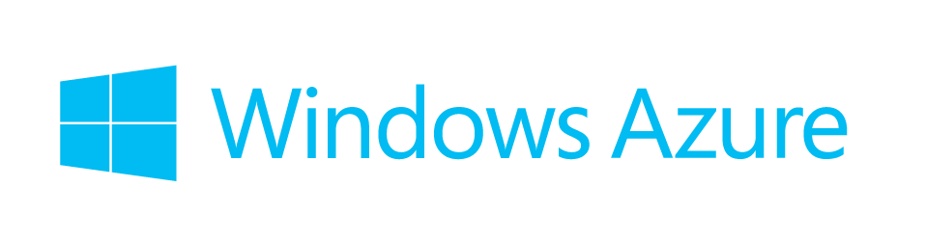
Windows Azure
Data Storage, Analysis, and Machine Learning
Service-Assisted Trustworthy Communication
Agent-Based High-Scale Computing
Federated Identity and Access Control
SQL Database
Table Storage
Blob Storage
HDInsight …
Service Bus AMQP
Cloud Services
MSR Orleans
Active Directory
Identity Foundation

Slide 44
Windows Azure as IOT Platform
Office 365, Dynamics, Microsoft Account, Bing
Intelligent Systems Services System Center Operations Manager
Unified HTTP/REST Management API & Portal
Team Foundation Server, Git
Visual Studio, Eclipse
Storage
Cloud Storage
SQL
Hadoop HDInsight
NoSQL
VM Disks
Compute
Web Sites
Cloud Services
Media Services
Java, PHP, Perl, Python, Ruby
VMs
Pre-Built Images + Open VM Depot
Active Directory
Multi Factor Auth
Mobile Services
Node.js
Network
Service Bus
Notification Hub
BizTalk Services
Partners Twilio, SendGrid
VPN
Public IP
Traffic Manager, Load Balancing, Firewall

Slide 45
Windows Azure Platform Mapping
3G
Identity Services (WAAD)
Service Bus
Web Portal
Platform Push Messaging
Mobile Platform Push Messaging
Mobile Solution Backend
Custom Protocol Gateway
Notification Hubs
Mobile Services Web Sites
Web Sites
SignalR Service Bus
Notification Hubs
Telemetry/Inquiry Dispatcher
Command/Notification API
Mobile Experience
Portal Experience
Service Bus & Web API
Telemetry Adapter Framework
Service Bus & Web API
Service Bus & Web API
Vehicle Information Systems
Fleet Information Systems
Driver Assistance Systems
SQL Database, Blob and NoSQL Storage Real-Time Analytics, HDInsight
Virtual Machines (IaaS) Cloud Services and Web Sites (PaaS)
Media Services
Service Bus + BizTalk Services + BizTalk Server + Virtual Networks
Corporate and Divisional Line of Business and Information Systems, 3rd Party Systems

Slide 46

OT/IT Convergence

Slide 47
Operational Technology
M2M Connectivity Providers
Mobility
Data Storage, Analysis, and Machine Learning
Logistics
Factory
Service-Assisted Trustworthy Communication
Cities
Entertainment
Agent-Based High-Scale Computing
Energy
Healthcare
Buildings
Federated Identity and Access Control
Retail

Slide 48
Information Technology
Workflow, Document Management and Communication
Sales and Marketing Information Systems
Customer Service and Support
Procurement and Logistics
Platform
Services
Billing, Collections, and Finance
People Management
Production Control

Slide 49
Operational and Information Technology Convergence
Mobility
M2M Connectivity Providers
Data Storage, Analysis, and Machine Learning
Workflow, Document Management and Communication
Logistics
Sales and Marketing Information Systems
Factory
Service-Assisted Trustworthy Communication
Customer Service and Support
Cities
Entertainment
Procurement and Logistics
Agent-Based High-Scale Computing
Platform
Services
Energy
Billing, Collections, and Finance
Healthcare
People Management
Buildings
Federated Identity and Access Control
Production Control
Retail

Slide 50


Smart Products Platform Services
Common Information Technology Services
Mobility
M2M Connectivity Providers
Data Storage, Analysis, and Machine Learning
Workflow, Document Management and Communication
Logistics
Skype Office 365
SharePoint
Sales and Marketing Information Systems
Factory
Service-Assisted Trustworthy Communication
Customer Service and Support
Cities
Windows Server/Azure
Entertainment
Procurement and Logistics
Agent-Based High-Scale Computing
SQL Server
Energy
Billing, Collections, and Finance
Healthcare
Hyper-V
People Management
Buildings
Federated Identity and Access Control
Dynamics AX
Production Control
Dynamics CRM
Retail

Slide 51

Why Cloud? Higher Scale, Lower Risk.
Example
2 Million Concurrent Device Goal
(High Density) 80,000 Concurrent Connections Per Node
80,000 * 128KB TCP Buffer, SSL State, Aggregation = ~10GB RAM Footprint
25 Front-End Nodes + 3 Failover Capacity Reserve
10+ Back-End Nodes for Data Offloading
Database and Analysis Capacity?
Disaster Recovery Standby Reserve
Scale-Ramp? Traffic Volume? Geo-Distribution?
Product Success?

Slide 52
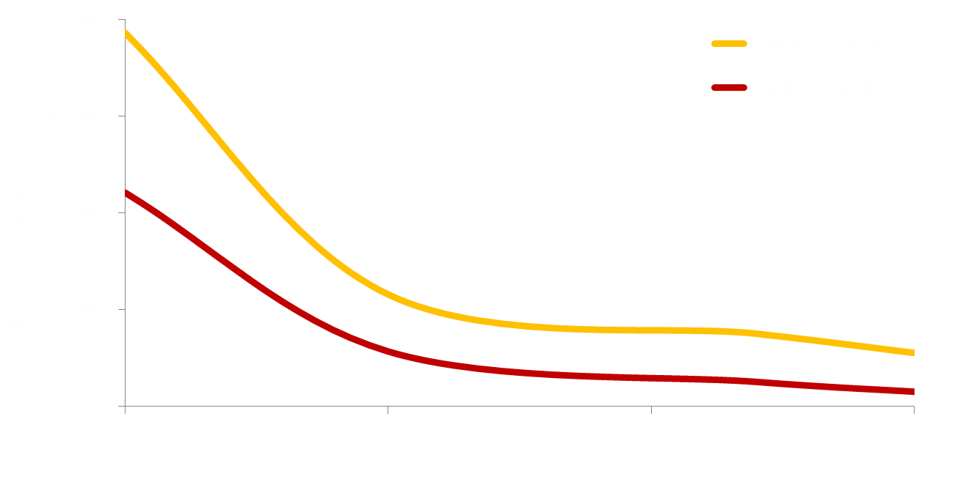


Public and Private Cloud Economics
SMB: >25x public cloud benefit
Enterprise: ~10x public cloud benefit
Public cloud steady state pricing

Slide 53
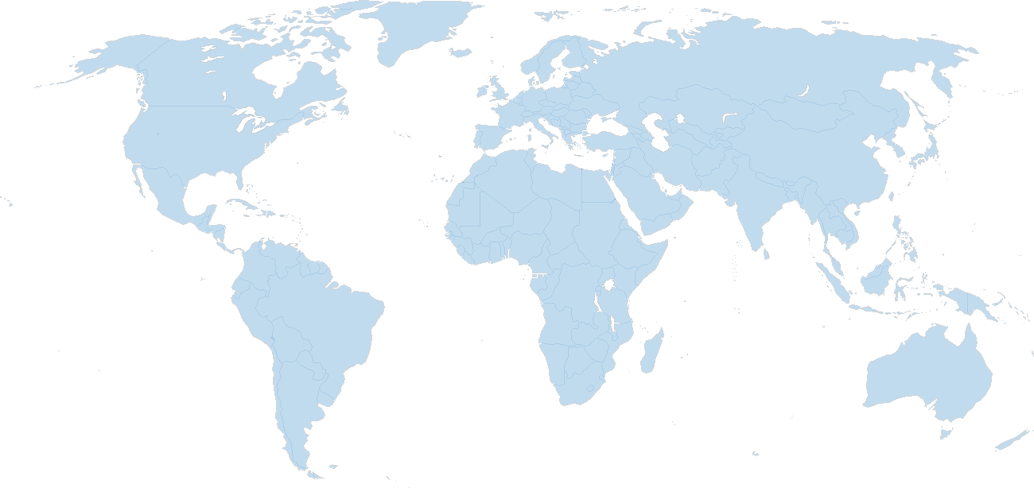
Global Footprint
North America
Europe
Asia/Pacific
N. Central – U.S. Sub-region
N. Europe
Sub-region
West – U.S. Sub-region
East – U.S. Sub-region
NE China (via 21Vianet) Sub-region
E Japan Sub-region
W. Europe
Sub-region
W Japan Sub-region
S. Central – U.S. Sub-region
E China (via 21Vianet) Sub-region
E. Asia Sub-region
SE Asia
Sub-region
Main Datacenter
CDN Node
Active Sub-region
Announced Sub-region
Partner-operated Sub-region
E Australia Sub-region
SE Australia Sub-region

Slide 54

Partnership Model
Operation & Support
Customer call center (Manufacturer or Outsource)
Solution help desk, solution operations (Microsoft and Partner)
Custom Development (Microsoft / Partner)
Platform Customization
Systems Integration
Microsoft Core Solution Platform
Core Platform Services
Unified Communication and Collaboration
Dynamics CRM and ERP
Solution Development

Slide 55
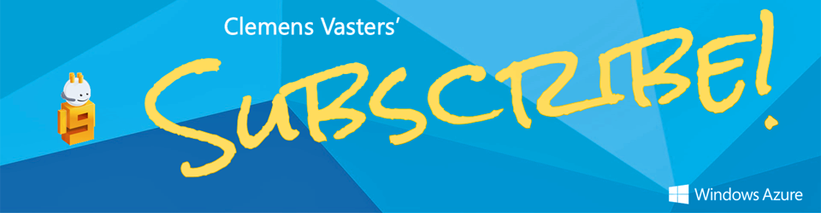
More? More!
https://channel9.msdn.com/blogs/subscribe

Slide 56
Thank You!
Clemens Vasters
Architect
Microsoft Corporation
@clemensv

